Slide 1

Introduction to PHP
PHP is a server-side scripting language used for developing dynamic websites and web applications. It's easy to use, flexible and extensively used across the web development industry. In this presentation, we will introduce you to the basics of PHP and guide you through the XAMPP installation process for Apache and MySQL.
Purpose and Use Cases
PHP can be used for tasks such as collecting form data, generating dynamic page content, or sending and receiving cookies. It's used in popular platforms like WordPress, Facebook, and Wikipedia.

Slide 2
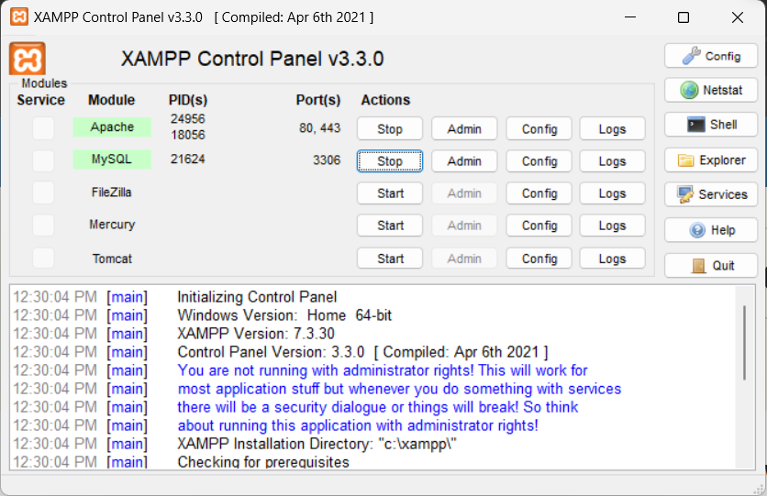
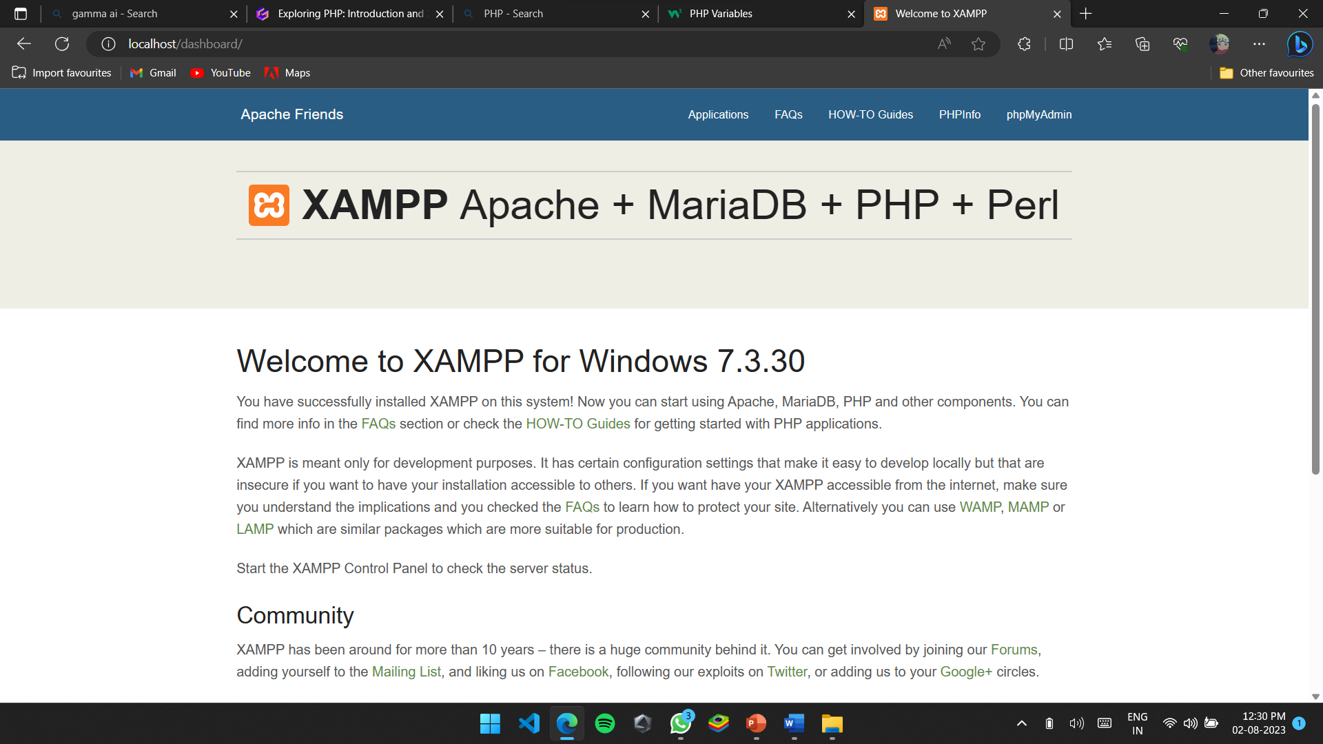
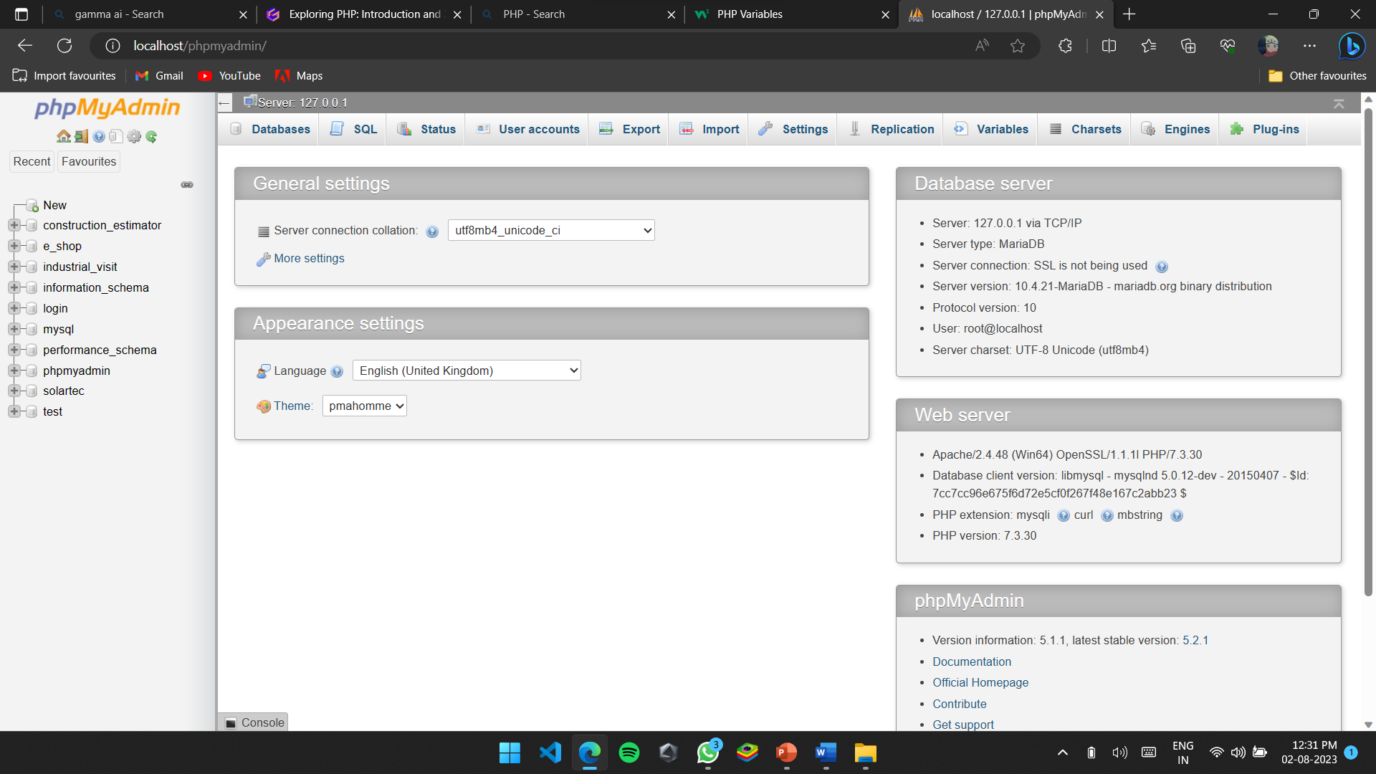
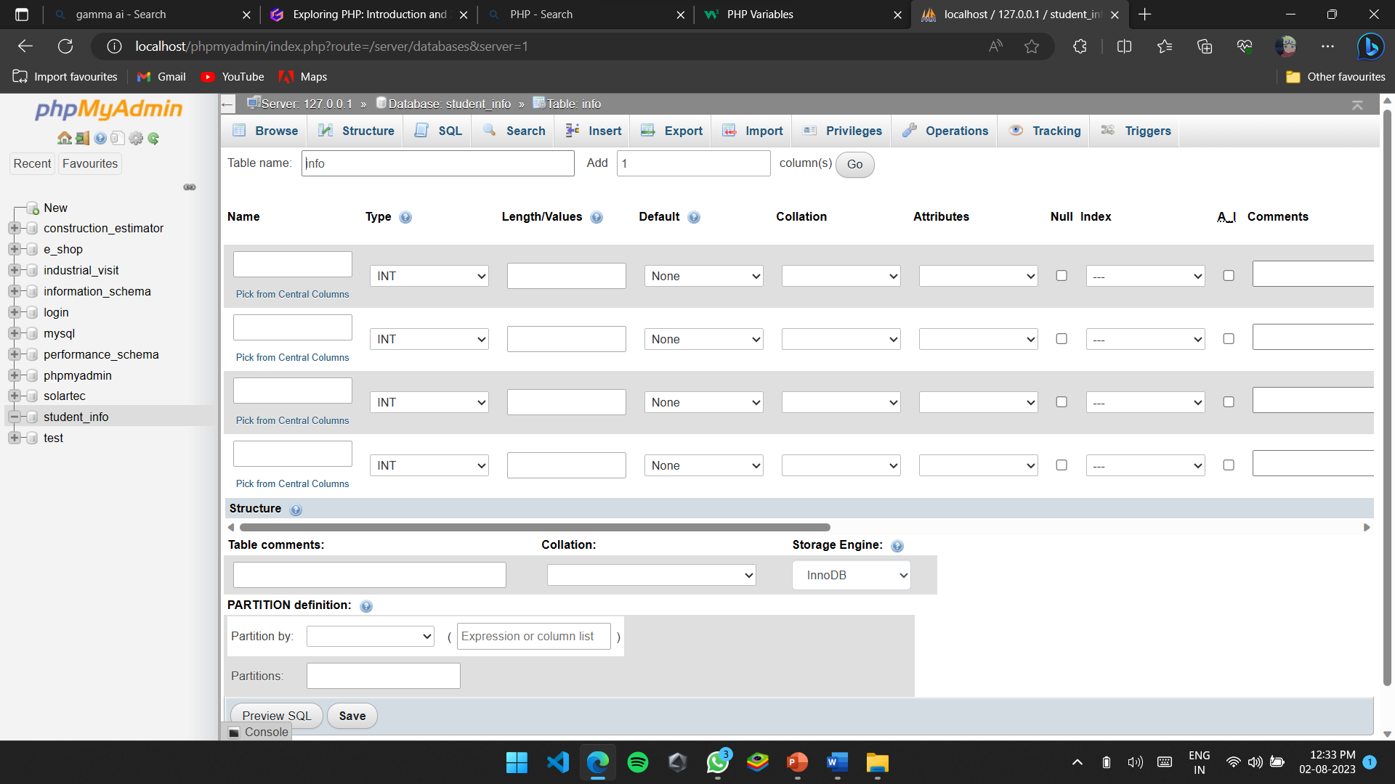
XAMPP Installation
2.Open XAMPP go to phpMyAdmin
1.Install XAMPP .In control Panel start Apache and MySQL modules.
3.Create table
4.Enter the columns and details of table.
.

Slide 3
Concepts of PHP
Constants
Datatype
Operator
Math
Sensitive
Insensitive
Array
Global
Array
Boolean
Float
Null
Object
String
Arithmatic
Assignment
Comparision
Conditional Statement
Increment Decrement
Logical
String
Abs
Min & min
Rand
Round
Pi
sqrt

Slide 4
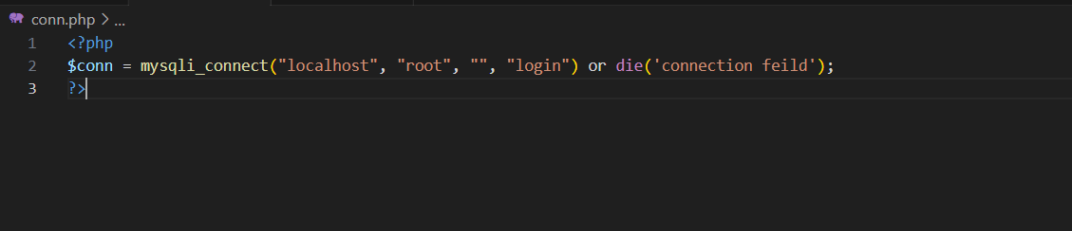
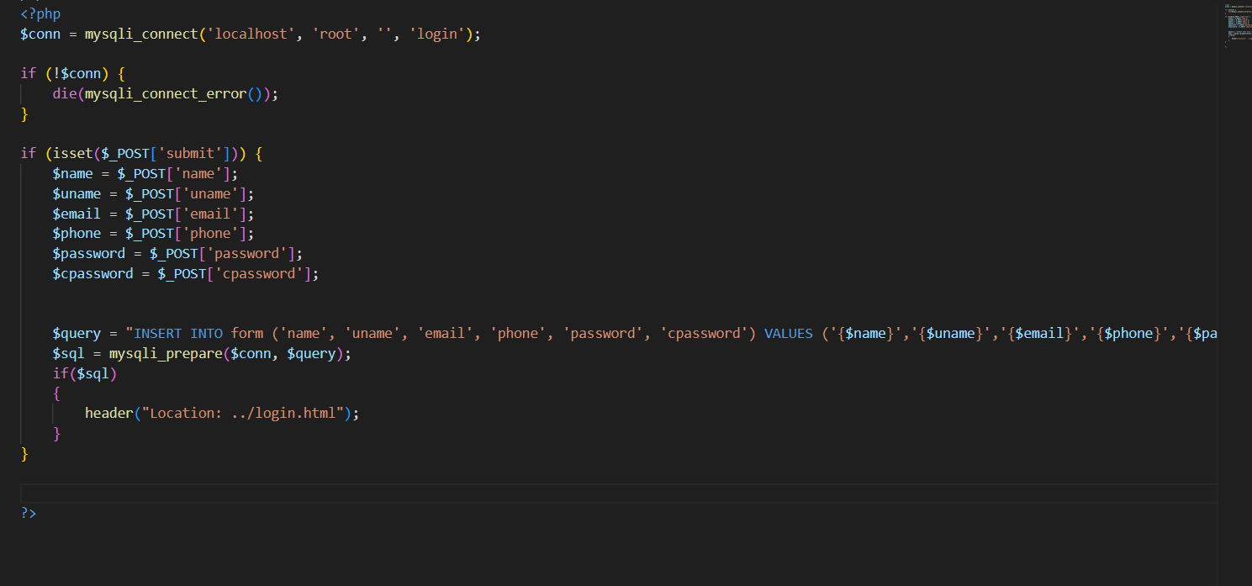
Example
The below code connects database to the HTML file.
This code is for signup page which fetches the data entered by user and saves the data in database.

